Slide 1

All Online:
From Testing to Completion
Chris Cook
Head of Program, STEPS
CQUniversity
24 June 2014

Slide 2
Contents
Online Testing
Online Orientation
Online Courses

Slide 3
Online Testing - Background
Prospective STEPS students complete 4 “tests”:
  Personal writing
  Computing questionnaire
  Mathematics test
  Literacy test
Until 2013, tests were paper based
Marking required time and resources

Slide 4
Online Testing - Project
Project aim to automate marking and streamline administration
Decision to put tests on CQUniversity’s Open Online Courses (MOOC) site
Personal writing, computing questionnaire and mathematics test “as is”; literacy test new

Slide 5
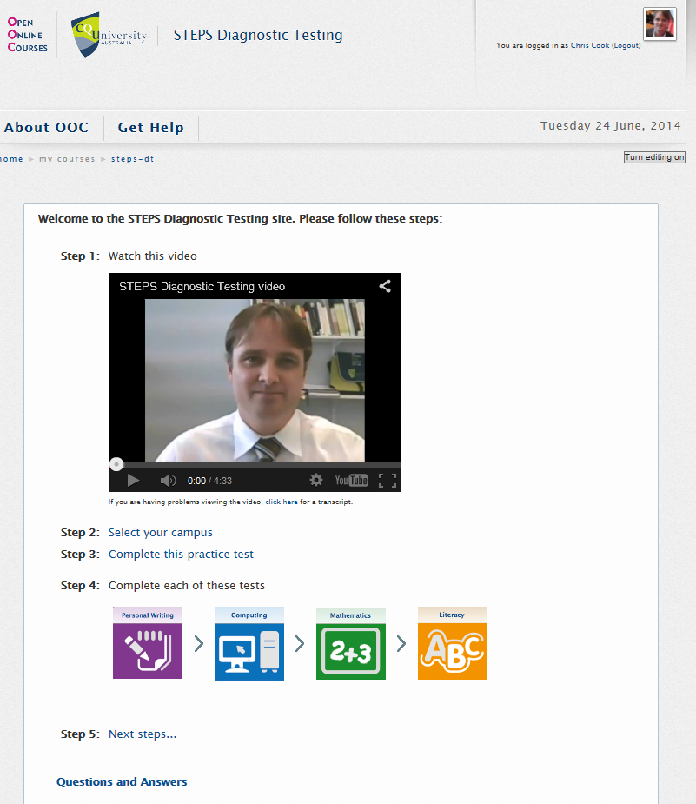
Online Testing - Development

Slide 6
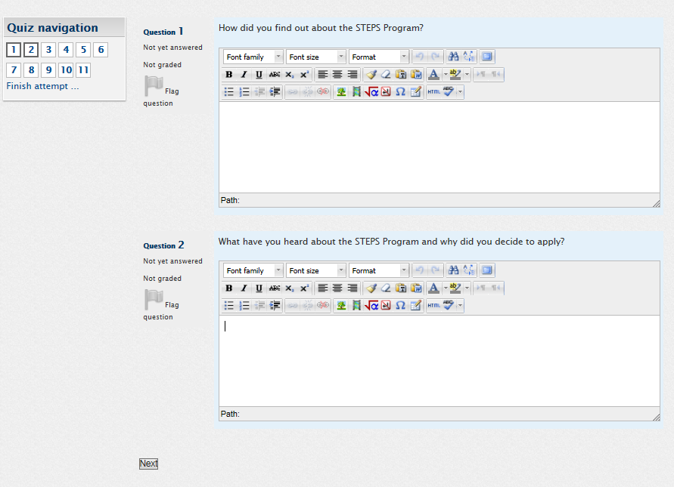
Online Testing – Personal Writing

Slide 7
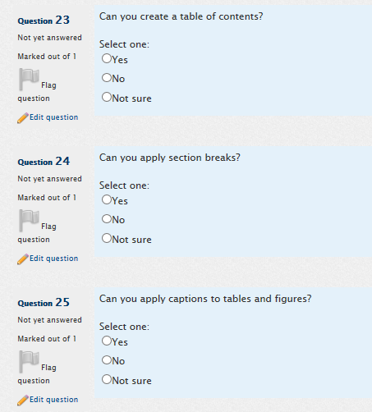
Online Testing – Computing

Slide 8
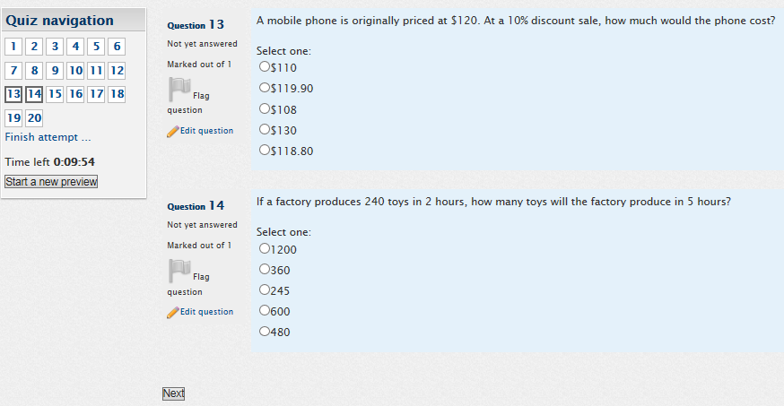
Online Testing – Mathematics

Slide 9
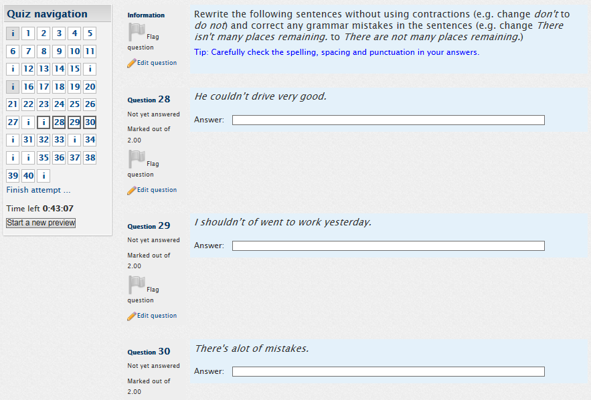
Online Testing – Literacy

Slide 10
Online Testing – Process
Prospective student emails application
STEPS Admin email testing information and enrolment form
Prospective student completes testing and emails completed enrolment form
Access Coordinator arranges interview to discuss results and organise study plan
Access Coordinator sends “start up email”, which includes link to STEPS Online Orientation

Slide 11
STEPS Online Orientation
Videos, information, activities and tasks for new students

Slide 12
Online Orientation - Background
Approx. 2/3 STEPS students study by distance education
Until 2014, separate on-campus Orientations for on-campus and distance cohorts
On-campus Orientation for distance students had relatively low attendance

Slide 13
Online Orientation - Project
Project aim to welcome and orient new distance students (and back up for on-campus students)
Decision to put Online Orientation on STEPS Program Moodle site
Embed videos, information, activities and tasks

Slide 14
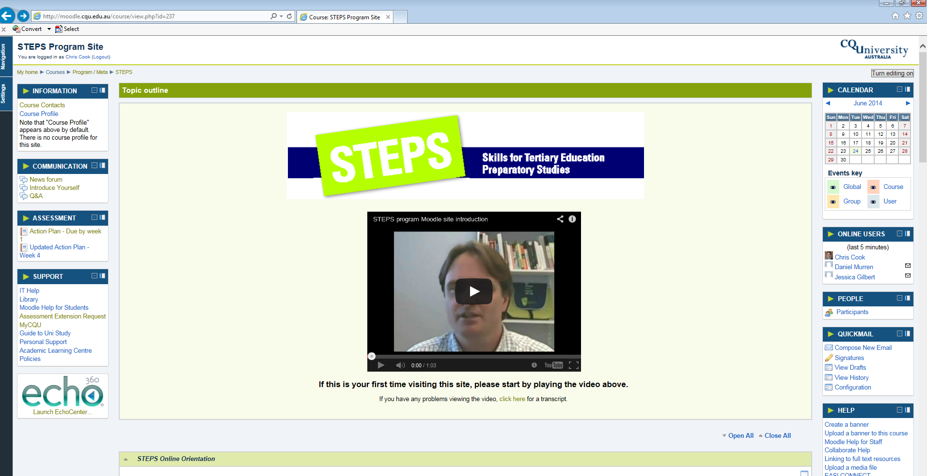
Online Orientation - Development

Slide 15
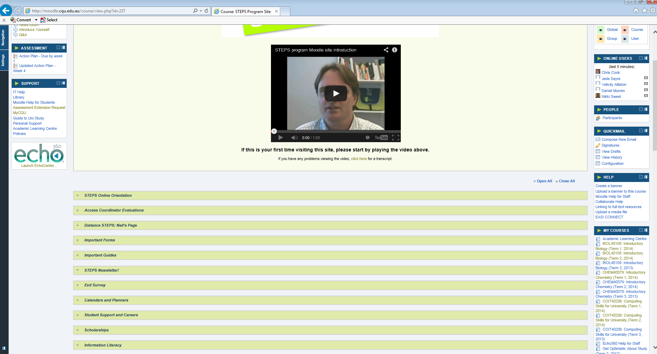
Online Orientation - Development

Slide 16
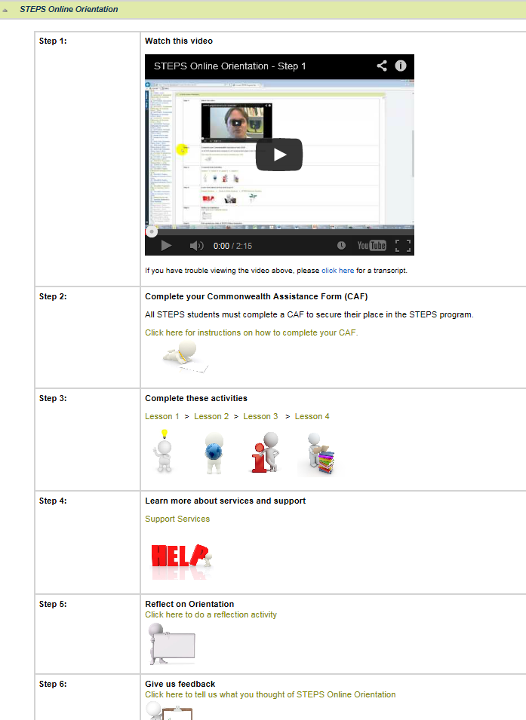
Online Orientation - Development

Slide 17
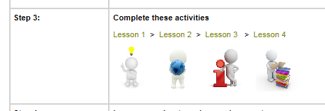
Online Orientation - Development

Slide 18
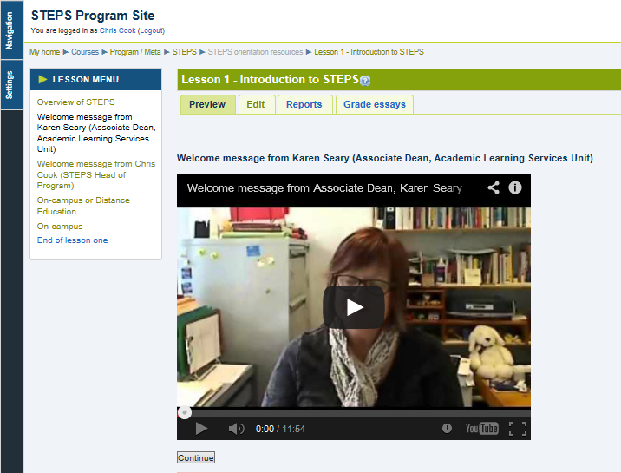
Online Orientation - Development

Slide 19
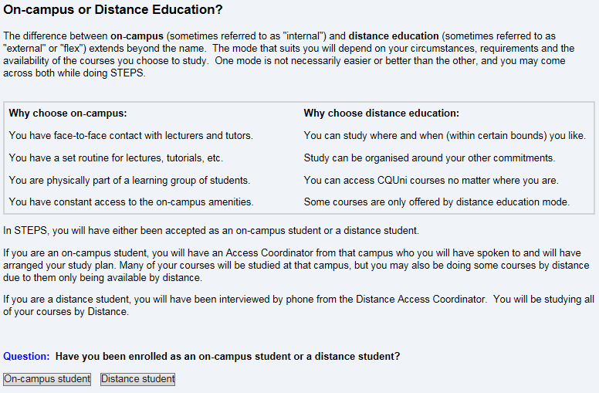
Online Orientation - Development

Slide 20
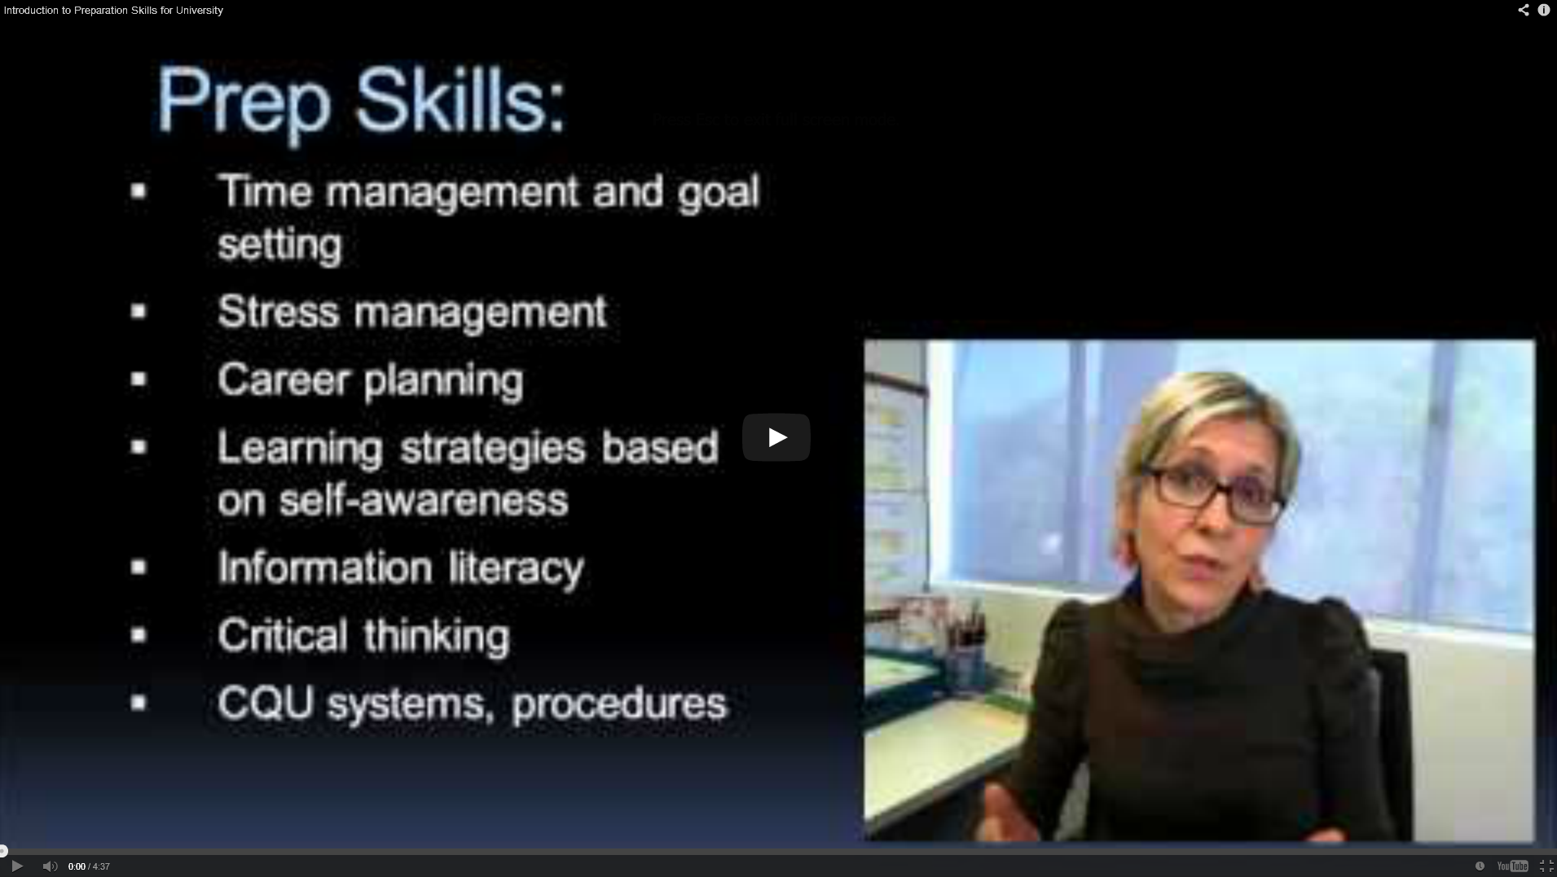
Online Orientation - Development

Slide 21
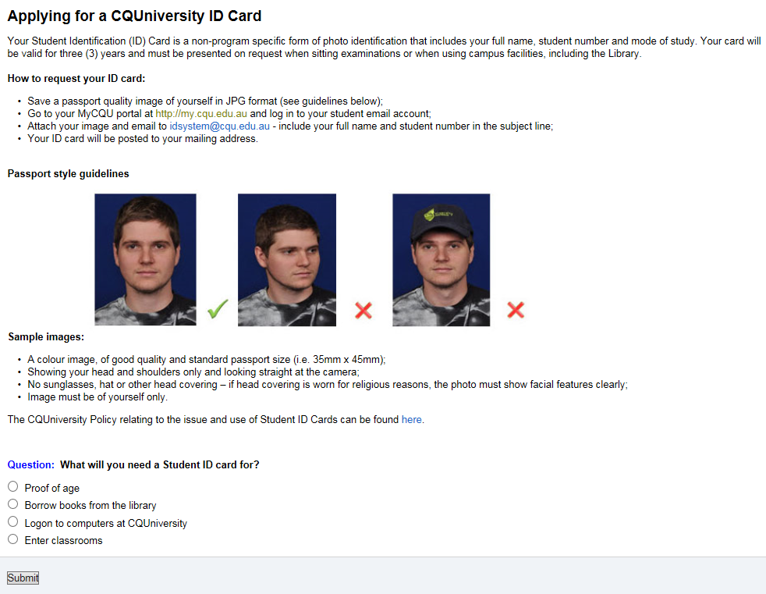
Online Orientation - Development

Slide 22
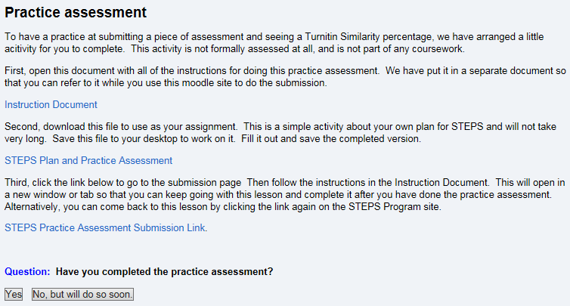
Online Orientation - Development

Slide 23
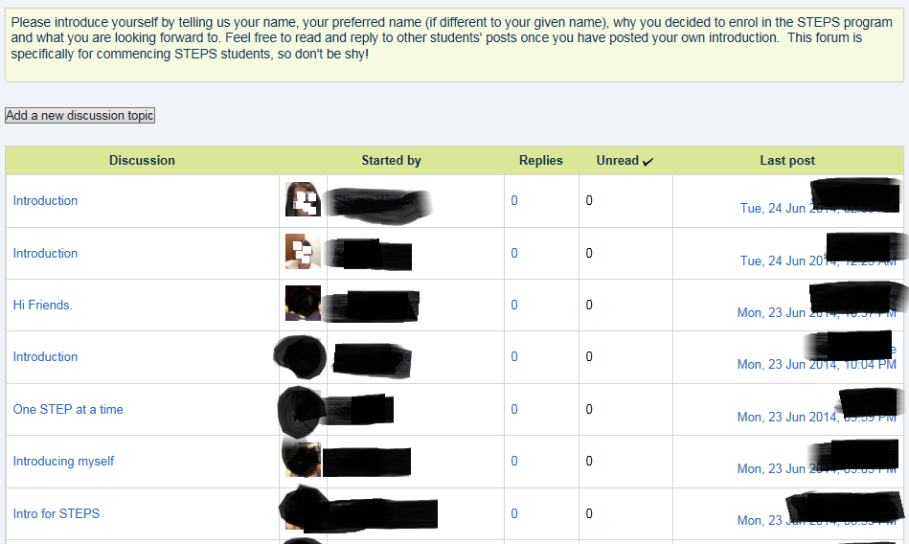
Online Orientation - Development

Slide 24
Online Orientation - Process
First introduced in Term 2, 2014
Students who haven’t completed can be prompted to complete
Feedback from students:
  89% satisfied, 9% not sure, 2% not satisfied
  “It made me feel more confident about ability to study.”
  “It was nice that the distance students could see their lectures and coordinators. It clearly explained how to complete all the activities which made the process a lot easier.”

Slide 25
STEPS Courses
Videos, information, activities and tasks for enrolled students

Slide 26
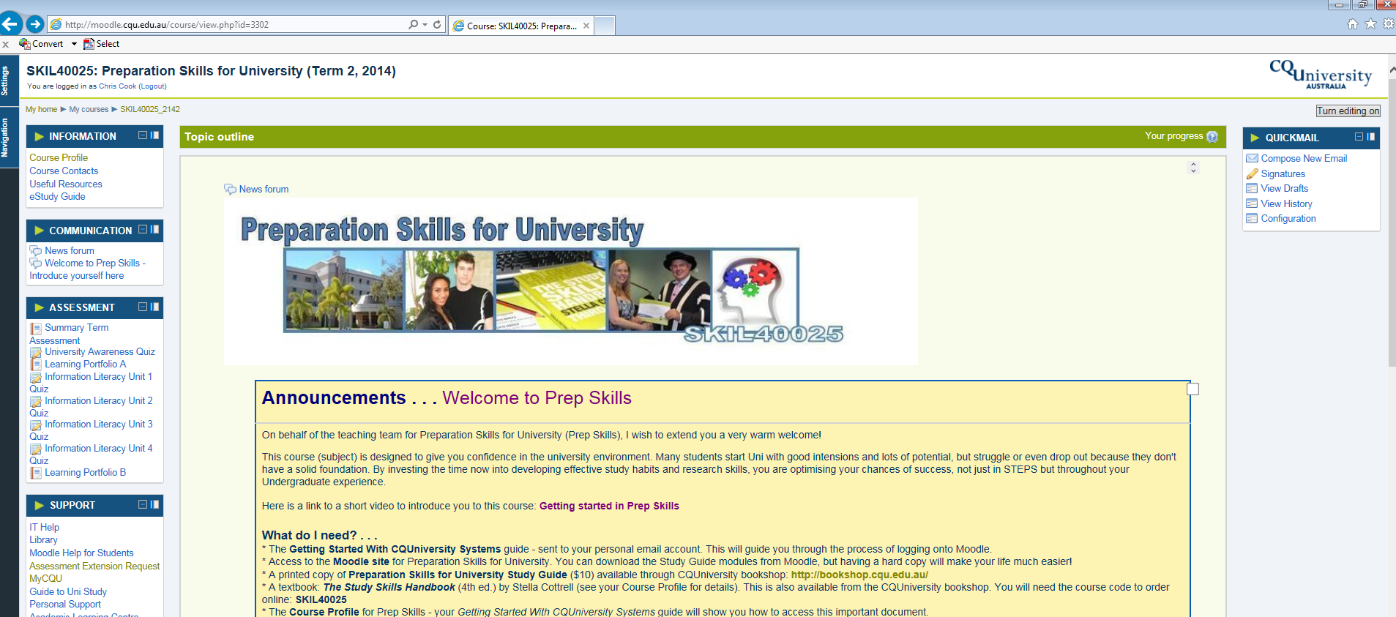
STEPS Courses – All online

Slide 27
Questions?

