Slide 1
The RAOC approach (or Review All Options Carefully!):
A framework for teaching information literacy in an enabling program
Jenny McDougall
CQUniversity

Slide 2
Today:
A confession
Information literacy and role of evaluation
Approaches to teaching IL
Links to critical literacy (Giroux)
Frameworks for evaluating information
The STEPS experience
Conclusions and implications

Slide 3
Confession
I am not a librarian.

Slide 4
What is ‘information literacy’?
Association for College and Research Libraries (ACRL, 2015)
“a set of abilities requiring individuals to recognize when information is needed and have the ability to locate, evaluate, and use effectively the needed information"
Notes:
Association for College and Research Libraries

Slide 5
What is ‘information literacy’?
“a set of abilities requiring individuals to
(1) recognize when information is needed
and have the ability to
(2) locate,
(3) evaluate, and
(4) use effectively the needed information."
(ACRL, 2015)
Notes:
Association for College and Research Libraries

Slide 6
Information literacy …
“Information literacy is a way of thinking rather than a set of skills.”
(Gibson, 2006, p. viii)
“information is abundant and intensive” in post-industrial 21st century (Bundy, ANZIIL, 2004, p. 3)
“a subset of independent learning … a subset of lifelong learning” (Bundy, ANZIIL, 2004, p. 5)
prerequisite for active citizenship (Australian Library and Information Association, 2001)
contextual – contingent on values and beliefs; discipline specific

Slide 7
Basic human right
The Alexandria Proclamation of 2005:
Information literacy and lifelong learning described as
“beacons of the Information Society, illuminating the course to development, prosperity and freedom…It is a basic human right in a digital world and promotes social inclusion in all nations." (UNESCO, 2005)

Slide 8
Graduate Attribute for Enabling Students/
CQUni Graduate Attribute
Information Literacy:
Find, retrieve, evaluate and apply information for academic purposes.

Slide 9
Teaching IL
Students find it hard! (Saunders, 2012)
Need for a cross-discipline approach (Bundy, ANZIIL, 2004; Taylor & Dalal, 2014)
Need for application to assessment (Bundy, ANZIIL, 2004)
Adaptable and reusable online learning resources can assist (Salisbury et al., 2012)

Slide 10

Links with critical literacy
Henri Giroux
Critical pedagogy: role of critical thinking in individual (and social) transformation
Need for “collective communication and critical dialogue” (1997, p. 27)
Introduce students to different forms of communication and specific vocabularies
Frameworks for evaluation = discourse of critique
Notes:
Critical pedagogy, cultural studies, youth studies, media studies. Academia needs to be more accessible and relevant.

Slide 11
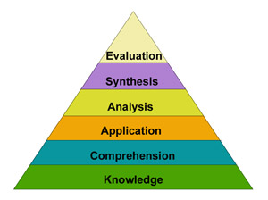
Evaluating information
… “evaluate reliability, validity, accuracy, authority, timeliness, and point of view or bias” (ACRL, 2015)
Commonly taught using checklists: series of concepts or questions
Higher order thinking . . .
as per Bloom’s taxonomy

Slide 12
IL in STEPS (enabling program, CQU)…
COURSE | ASSESSMENT of IL
Preparation Skills for University (core course) | Online quizzes
Essay Writing for University | Annotated bibliography Research essay
Technical Writing for University | Report

Slide 13
Evaluation frameworks in STEPS (2012-2014)
PSU (ILUnit 1) | PSU (ILUnit 4) | EWU | TWU | IL Guide
Author (authority) Site’s sponsor/ publisher Purpose Accuracy Timeliness Suitability Uniqueness | R elevance E xpertise V iewpoint I ntended audience E vidence W hen published | Relevance Coverage Trustworthiness and authority Objectivity Currency | How was evidence collected? How reliable? Other evidence? Other interpretations? Anything overlooked? Other research to back up claims? (adapted from Zeegers et al., 2008) | Currency Reliability Coverage Accuracy Author credentials

Slide 14
RAOC framework (2015) . . .
Relevance
Authority
Objectivity
Currency
Notes:
Acknowledgements: contributions from Dr Wendy Davis, and Helen Holden

Slide 15
Relevance | Is this information relevant to my research topic?
 | What aspects of my topic does this information cover?
Authority | Who has produced the information?
 | Where has the information been published?
 | Does the information show the author has used research?
Objectivity | Does the resource present a balanced view?
 | Is the information presented in a factual way?
Currency | When was the information published?
 | In the case of webpages, when was it last updated?

Slide 16
Review All Options Carefully!
Relevance
Authority
Objectivity
Currency

Slide 17
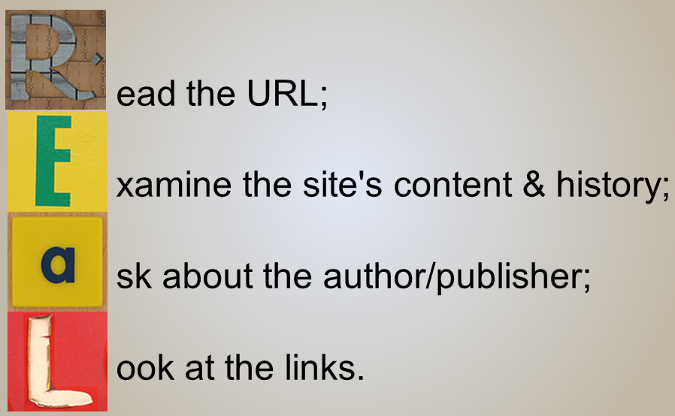
Alan November (Web Literacies for Educators, 2008)

Slide 18
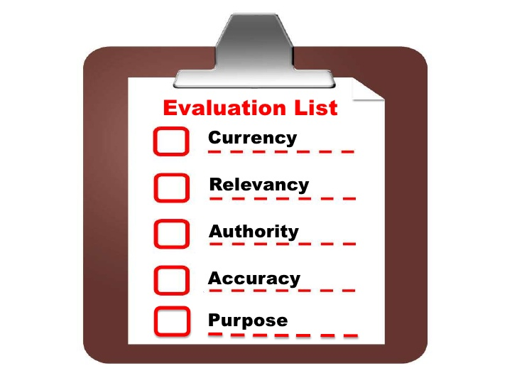
The CRAAP test …California State University

Slide 19

The SMELL test …John McManus, Mediashift (journalism education)
Source Motivation Evidence Logic Left out

Slide 20
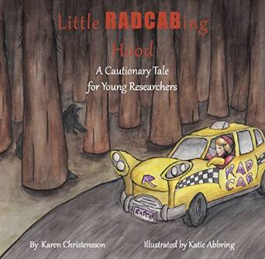
Relevance, Appropriateness, Details, Currency, Authority, Bias (RADCAB) … Karen Christensson

Slide 21
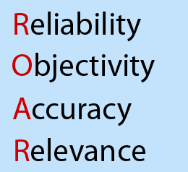
Subject VIKO
(Norwegian University of Science & Technology)

Slide 22
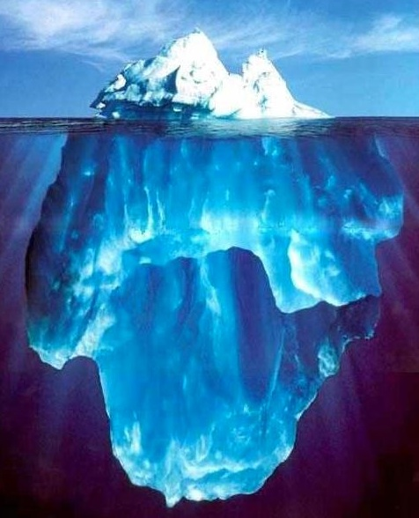
Limitations of checklist approach
Checklists promote mechanical technique (Meola, 2004)
Need to encourage students to go
beyond ‘Free Web’
Notes:
Encourage students to compare and contrast sites they find
Check accuracy by checking information against different sources

Slide 23
Changing nature of information
Markahm Nolan (2012)
‘How to separate fact and fiction online’, TED talk . . .
http://www.ted.com/talks/markham_nolan_how_to_separate_fact_and_fiction_online
Changing nature of information →
Need to evaluate imagery, audio
and videos
More research freely available

Slide 24
Conclusions & Implications
Teaching IL and how to evaluate information …
Shared responsibility
Embed IL across the curriculum (& in assessment) – beyond ‘cattle dipping’ approach
Give students language of critique e.g. RAOC
Use consistent, accessible language; common resources
Changing nature of information → Need for evaluation

Slide 25
References
Association of College and Research Libraries (ACRL). (2015). Information literacy competency standards for higher education. Retrieved from http://www.ala.org/acrl/standards/informationliteracycompetency
Australian Library and Information Association. (2006). Statement on information literacy for all Australians. Retrieved from https://www.alia.org.au/about-alia/policies-standards-and-guidelines/statement-information-literacy-all-australians
Bundy, A. (Ed.). (2004). Australian and New Zealand information literacy framework: Principles, standards and practice (2nd ed.). Adelaide, SA: Australian and New Zealand Institute for Information Literacy.
Gibson, C. (2006). Student engagement and information literacy. Chicago, IL: American Library Association.
Giroux, H. (1997). Pedagogy and politics of hope: Theory, culture, and schooling. Boulder, CO: Westview.

Slide 26
References (cont.)
Meola, M. (2004). ‘Chucking the checklist: A contextual approach to teaching undergraduates web-site evaluation’. Libraries and the Academy, 4(3),
331–334.
Salisbury, F.A., Karasmanis, S., Robertson, T., Corbin, J., & Hulel, H. (2012). Transforming information literacy conversations to enhance student learning: New curriculum dialogues. Journal of University Teaching & Learning Practice, 9(3). Retrieved from http://ro.uow.edu.au/jutlp/vol9/iss3/4/
Saunders, L. (2012). Faculty perspectives on information literacy as a student learning outcome. The Journal of Academic Librarianship, 38(4), 226–236.

Slide 27
References (cont.)
Smale, M.A. (2013, February 13). Evaluating strategies for evaluating sources, Information Literacy at CUNY [Web blog post]. Retrieved July 1, 2015, from https://infolit.commons.gc.cuny.edu/2013/02/13/evaluating-strategies-for-evaluating-sources/
Taylor, A. & Dalal, H. A. (2014). Information literacy standards and the World Wide Web: Results from a student survey on evaluation of Internet information sources. Information Research, 19(4), paper 645. Retrieved from http://InformationR.net/ir/19-4/paper645.html
UNESCO. (2003). The Prague Declaration – ‘Towards an Information Literate Society’, Prague, Czech Republic. (20–23 September 2003). Retrieved from http://portal.unesco.org/ci/en/ev.php-URL_ID=19636&URL_DO=DO_TOPIC&URL_SECTION=201.html

