Slide 1
TERTIARY PREPARATION PATHWAY

Slide 2
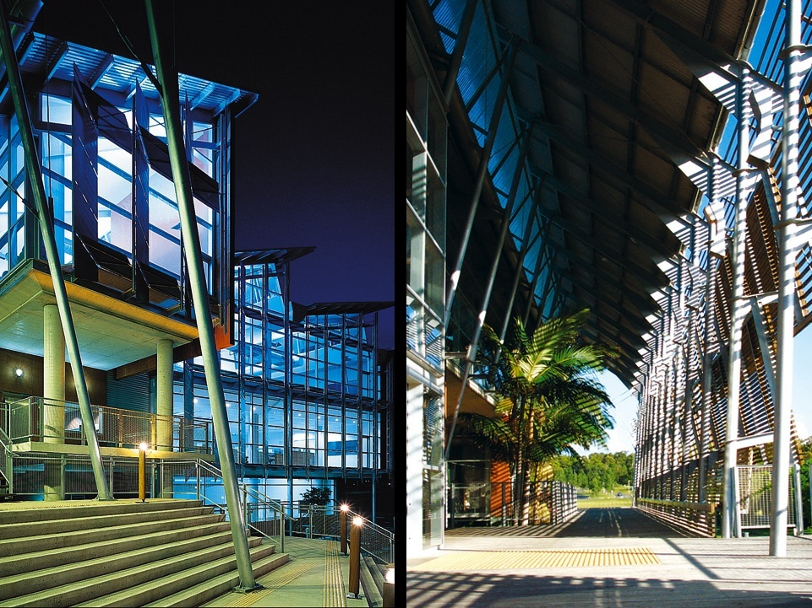
Faculty of Science, Health, Education and Engineering
Preparatory and Enabling Unit (PEU)
Tertiary Preparation Pathway (TPP)
Tertiary Enabling Program (TEP)
Tertiary Support Option (TSO)

Slide 3


Off Campus Sites

Slide 4


Entry Requirements
TPP applicants must be a minimum of 17 years of age (International students must be 18 years old).
Students from non-English speaking backgrounds must satisfy the University’s English language requirements.
www.usc.edu.au/englishrequirements

Slide 5
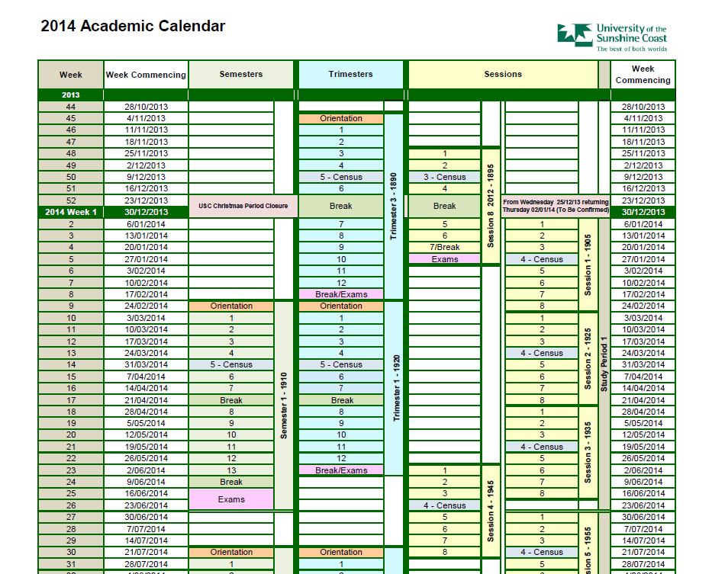
Semester 1
13 weeks
Lecture 1 hour/week
Semester 2
13 weeks
Lecture 1 hour/week
Session 8
6 weeks
Lecture 2 x 1 hour/week
Workshop 2 or 3 hours/week
Workshop 2 or 3 hours/week
Workshop 2 x 2 or 3 hours/week
Notes:
Face to face

Slide 6

Courses
TPP101 Academic Skills
TPP102 Computer Literacy
TPP103 Chemistry
TPP104 Mathematics
TPP105 Statistics
TPP106 Introduction to Aboriginal and Torres Strait Islander Societies
TPP107 Contemporary Australia
TPP108 An introduction to Working within the Community
TPP109 Biology
TPP111 Business Study Skills

Slide 7

Workbooks $10-20

Slide 8
Enrolment Numbers

