Slide 1
Left, right and centre
The positioning of language and literacies in enabling education programs in Australia
Sally Baker and Evonne Irwin

Slide 2
Two questions to scope the context
How can we define 'enabling education' when it's such a disparate and relatively new field?
Why focus on academic literacies in enabling education?

Slide 3
What is enabling education?
offered by an Australian university
free to domestic students
carries no/ limited credit towards an undergraduate qualification

Slide 4
A national stocktake of enabling education
We have surveyed 26 universities and looked at 35 enabling programs. Our research design involved:
A desktop review of publicly available information on 'pathway'/ 'preparation'/ 'foundation' programs for course information and key contacts
A telephone survey and follow-up emails with key personnel in each of the universities identified as offering enabling programs
Collection of key curriculum documents that underpin ALL teaching and learning, including course outlines, assignment rubrics and marking matrices

Slide 5
Research questions
What enabling/ foundation/ pathways programs are available across Australia?
What ALL modules do they offer (core/ optional)?
What ALL support is available
What LBOTE support is available and is there specific LBOTE delivery?
What pathways into UG study do these programs offer?

Slide 6
Findings
Creation of a typology of enabling, sub-degree & access programs across Australia
Mapping of the ALL provision (units, content - practices, tasks, assessments - & support) according to NES & LBOTE students
Exploration of the composition of the curricula of these programs and development of 5 models of enabling programs, specifically viewed through the lens of ALL

Slide 7
Academic language and literacies in enabling education
All enabling programs offer some explicit form of ALL teaching and learning, with the exception of one.
22/35 programs embed this ALL teaching and learning within a central 'UPrep' module
9/35 programs offer at least one stand-alone ALL unit without a UPrep module
12/35 programs offer both a UPrep and at least one ALL unit

Slide 8
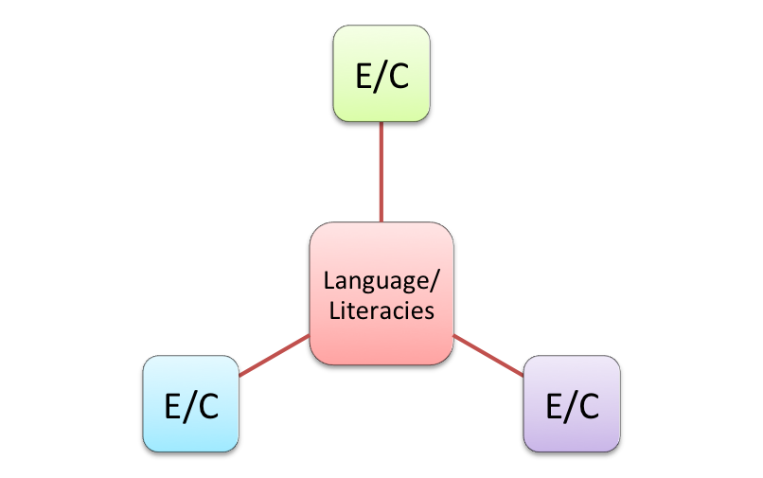
Five models of enabling programs
Model 1a—Language and Literacies at the centre/core of the program and either compulsory or elective modules curriculum-mapped to core course (1 semester)

Slide 9
Five models of enabling programs
Model 1b—Language and Literacies at the centre/core of the program and either compulsory or elective modules curriculum-mapped to core course (2 semesters)

Slide 10
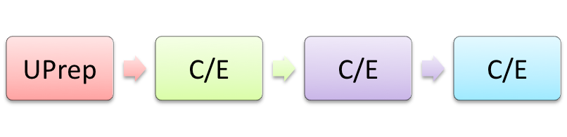
Five models of enabling programs
Model 2a—Compulsory UPrep module plus either compulsory or elective modules not curriculum-mapped (1 semester)
Model 2b—Compulsory UPrep module plus either compulsory or elective modules not curriculum-mapped (2 semesters)

Slide 11


Five models of enabling programs
Model 2c—Compulsory UPrep module and other electives or compulsory modules (2 courses x 2 semesters)

Slide 12
Five models of enabling programs
Model 2c—Compulsory UPrep module and other electives or compulsory modules (2 courses x 2 semesters)

Slide 13
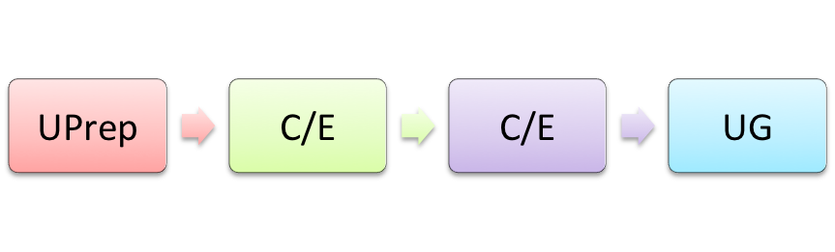
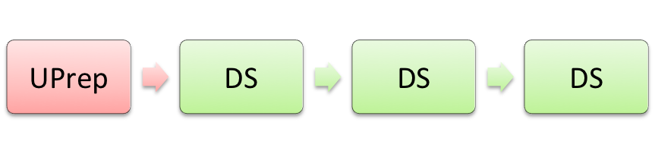
Five models of enabling programs
Model 3—Compulsory UPrep module plus either compulsory or elective modules and one or more undergraduate/faculty-based modules not curriculum-mapped (1 semester)
Model 4—Compulsory UPrep module plus discipline-based streamed units/courses not curriculum mapped (1 or 2 semesters)

Slide 14
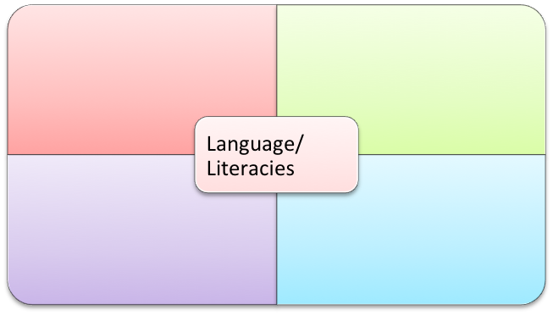
Five models of enabling programs
Model 5—One Program, one course with language and literacies/study skills at the centre

Slide 15
Left, Right or Centre?
What does 'good practice' look like?
ALL should be a core part of the curriculum
ALL should be at the centre
ALL should support, frame and be a central part of the disciplinary units

Slide 16
Left, Right or Centre?
We view Model 1(a & b) as offering the most effective and transformative approach to teaching, assessing and supporting students' with their language: curriculum mapping is the key.
Model 5 also offers this potential

Slide 17
So what?
Going back to our argument that ALL constitutes the core business of enabling education, the limited focus and research in this area needs addressing. This research was borne out of practitioner concern with our courses and its intention was to:
focus the spotlight onto the importance of ALL in enabling programs;
challenge deficit framings of language and literacies; and
generate conversations amongst enabling practitioners and researchers and look at what works, what needs more work and what could work better
What's next?? We need to collaborate... :)

Slide 18
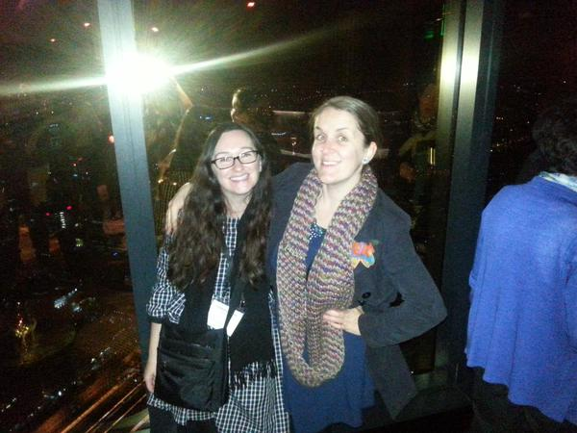
Thank you
Questions?
Evonne Irwin
Digital Content Manager
English Language and Foundation Studies Centre
University of Newcastle
Australia
Email: Evonne.Irwin@newcastle.edu.au
Twitter: @eleei
Sally Baker
Research Associate
Centre of Excellence for Equity in Higher Education
University of Newcastle
Australia
Email: Sally.Baker@newcastle.edu.au
Twitter: @SallyBaker25

