Slide 1

4th Enabling Educators
Symposium
CQU Bundaberg 2014
Notes:
Acknowledge the traditional custodians of the land

Slide 2

Student Voices from the Soapbox
Marguerite Westacott and Kelly Chambers
Associate Lecturers
Tertiary Preparation Pathway USC
Notes:
Image credit

Slide 3

What is computer literacy?

Slide 4

Student Response System
Google – ‘appgosoapbox’
Enter the access code – ‘computer literacy’
Notes:
https://app.gosoapbox.com/

Slide 5
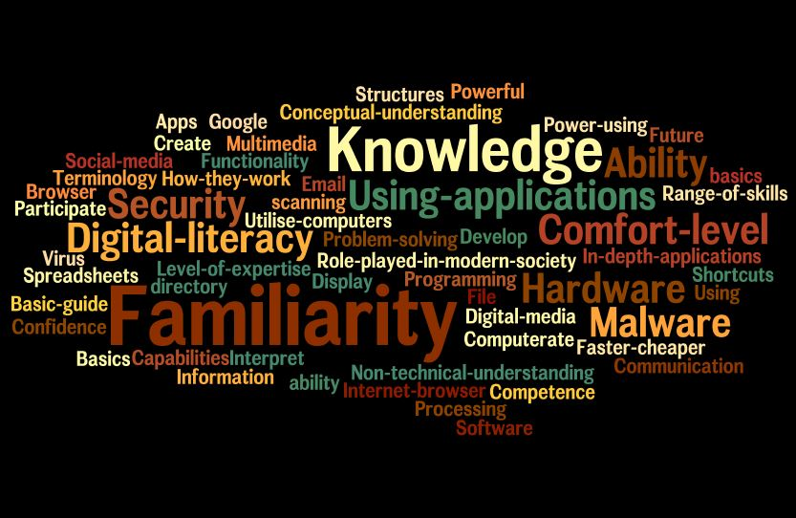
Wordle
Notes:
http://www.wordle.net/
Reflections in Wordle from 2014 semester 1
fa·mil·i·ar·i·ty [fuh-mil-ee-ar-i-tee, -mil-yar-] noun, plural fa·mil·i·ar·i·ties.
1. thorough knowledge or mastery of a thing, subject, etc.
2. the state of being familiar; friendly relationship; close acquaintance; intimacy.
3. an absence of ceremony and formality; informality.
4. freedom of behavior justified only by the closest relationship; undue intimacy.
5. Often, familiarities. an instance of such freedom, as in action or speech.
http://dictionary.reference.com/browse/familiarity

Slide 6
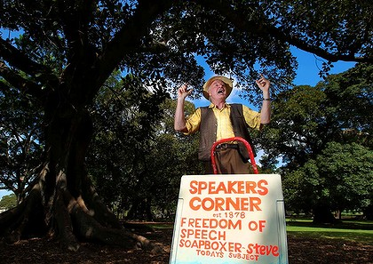
Provide a platform for feedback
Provide a space to engage
Role model digital applications
Notes:
Image from - http://www.smh.com.au/nsw/loud-proud--and-willing-to-talk-under-wet-cement-20110318-1c0jd.html
How we place ourselves, within any learning context, whether formal or informal, is fundamental. This is not just a matter of “attitude”, in so far as it defines our own engagement with the material; it represents the very stuff of learning itself… how we position ourselves towards [each other] in any educational setting… is what governs the limits and possibilities of our engagement together, what shapes and defines the material we construct out of that engagement. (Salmon, 1989, p. 231)

Slide 7
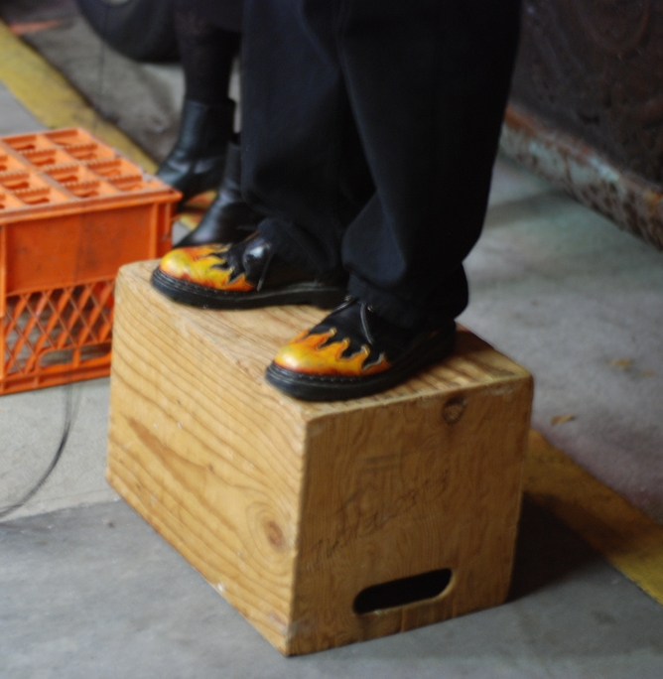
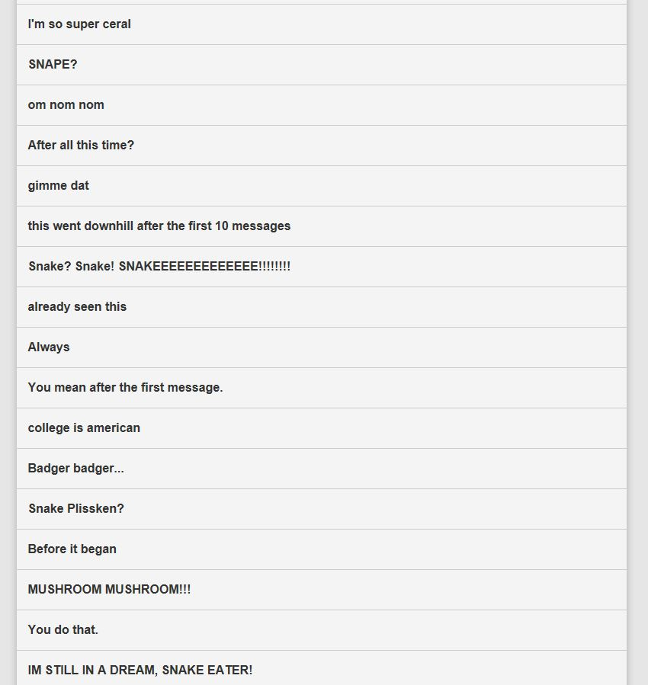
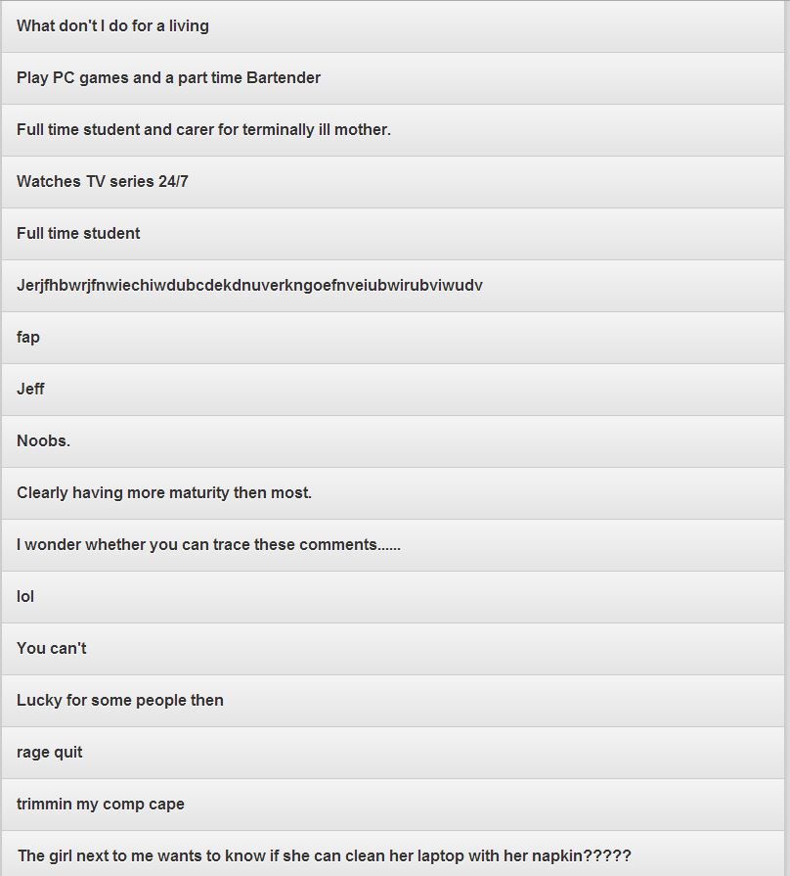
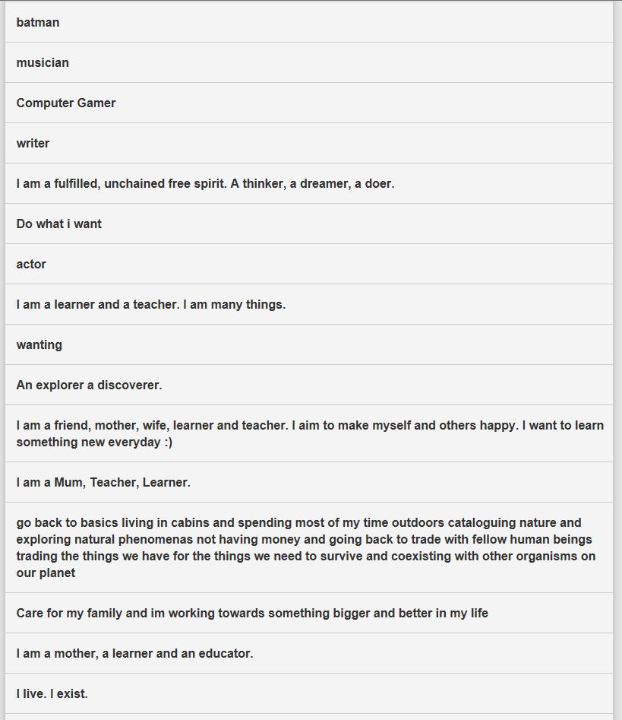
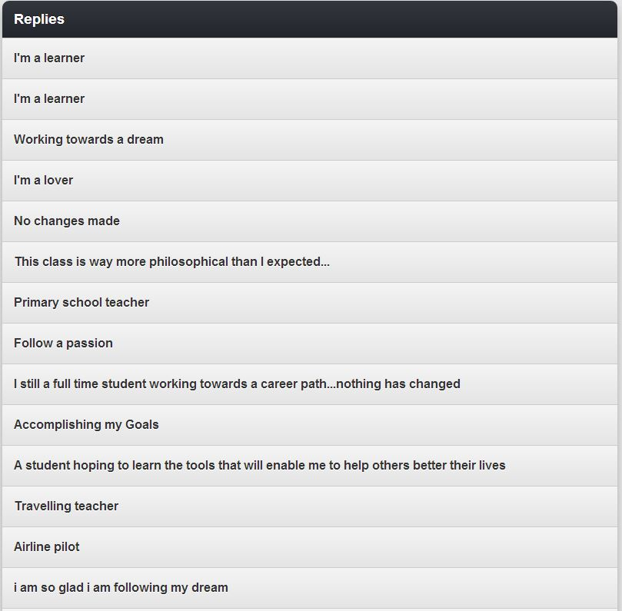
From the soapbox ...
Notes:
Image from - http://www.metro.us/newyork/news/2013/04/15/bostonians-invited-to-hop-on-the-emerson-college-soapbox-to-share-ideas-on-immigration-reform/
Philosophical approach – is learning
Bamber and Tett suggest the answers to the real complexities and challenges of learning in HE (and they speak specifically about ‘non-traditional students) is that they do not lie in the provision of tailored modular programs, access courses, and so on. They ‘lie in much finer nuances of expressing respect, concern and care for individuals, and in giving priority to the need for adults to build upon and make sense of their own and other’s life worlds’ (Bamber & Tett, 2000, 61-2).
Transformational experience – is learning
Kolb (1993, p155)
Defines learning as…
‘A process whereby knowledge is created through the transformation of experience. This definition emphasises several critical aspects of the learning process as viewed from the experiential perspective. First is the emphasis on the process of adaptation and learning as opposed to content or outcomes. Second is that knowledge is a transformation process, being continuously created and recreated, not as an independent entity to be acquired or transmitted. Third, learning transforms experience in both its objective and subjective forms. Finally, to understand learning, we must understand the nature of knowledge and vice versa’.

Slide 8
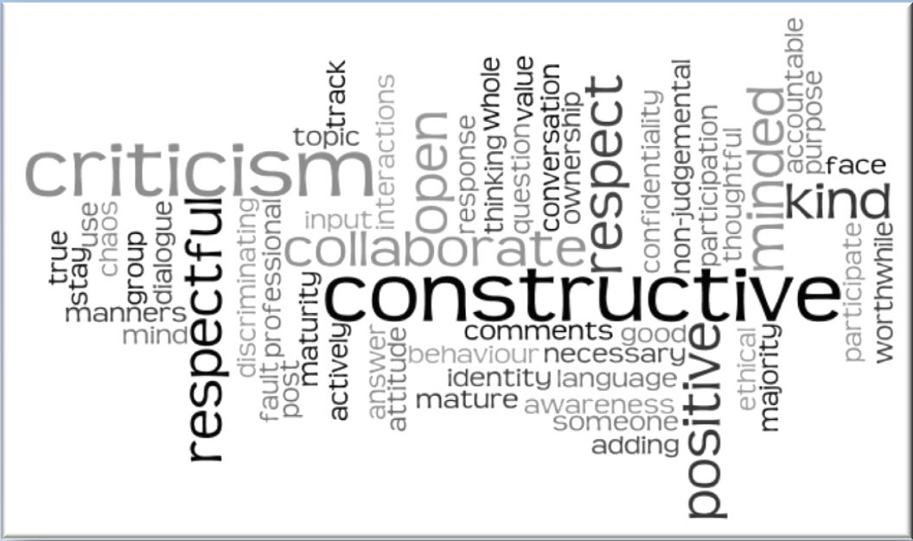
...student voice...

Slide 9
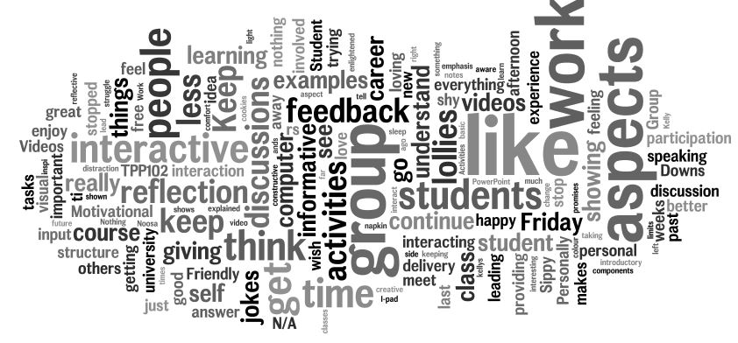
...student voice...
Notes:
Feedback on the lectures

Slide 10

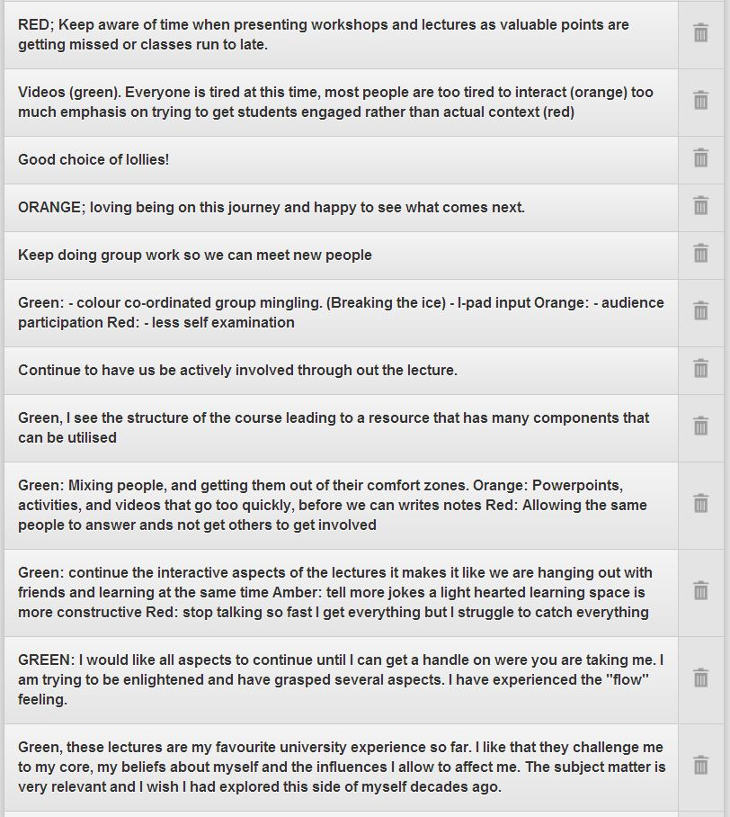
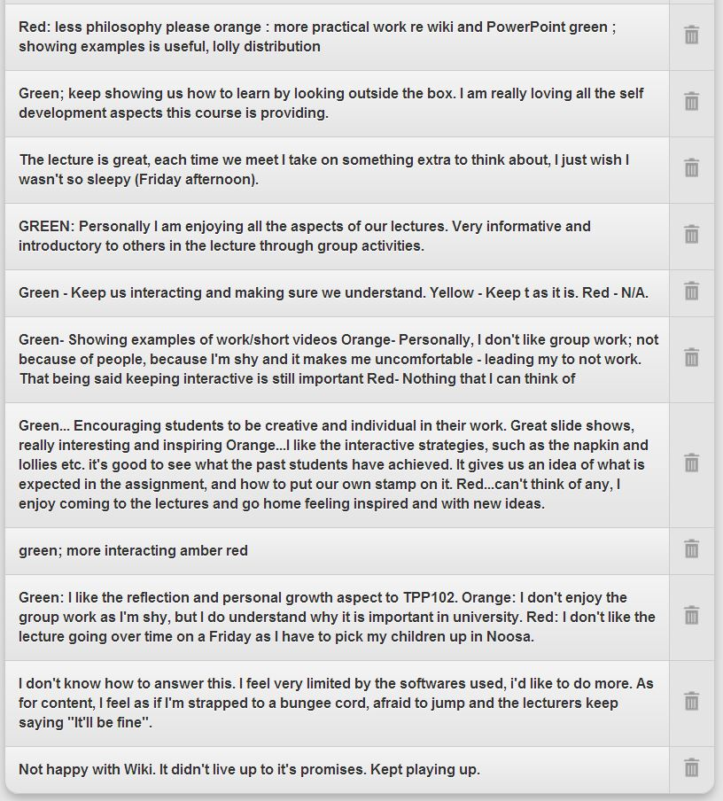
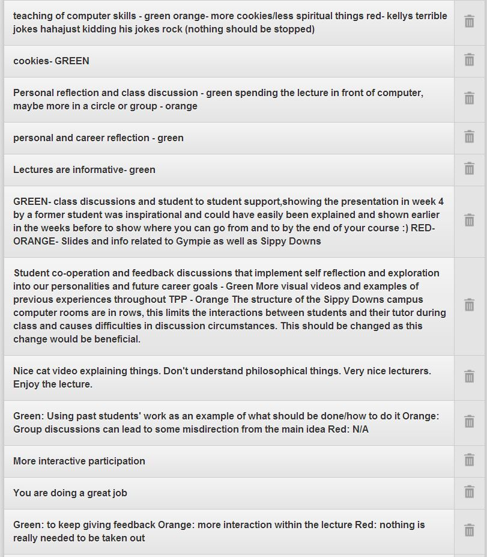
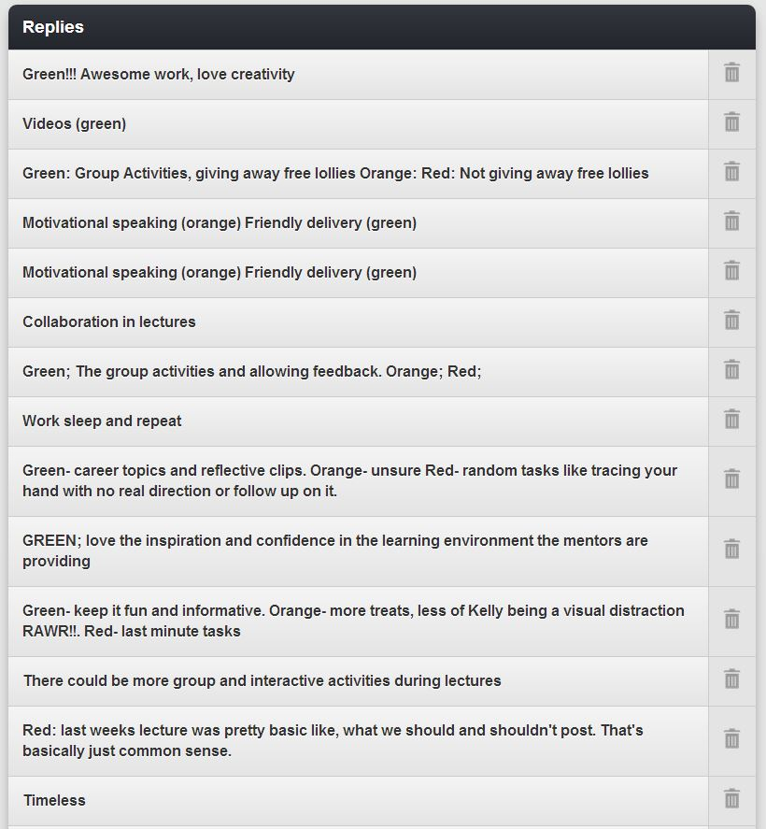
...from the soapbox...
Notes:
NEED OTHER PAGE

Slide 11
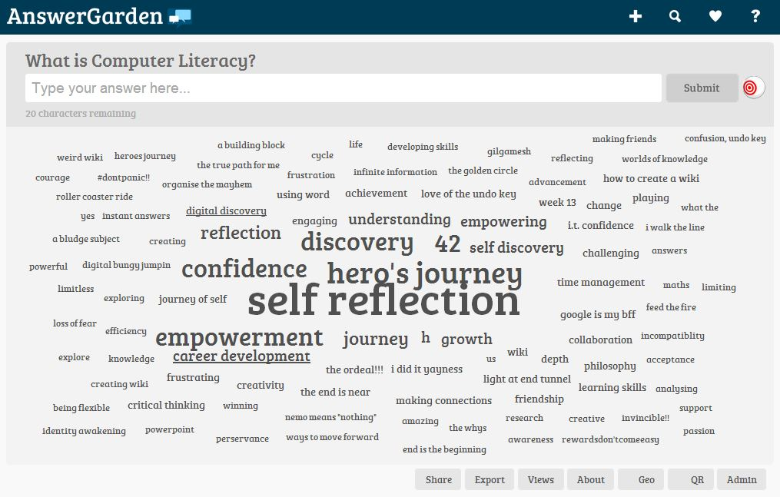
Answergarden
Notes:
http://answergarden.ch/

Slide 12
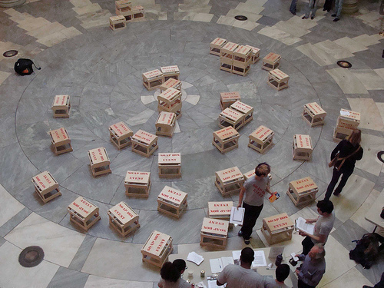
iPad video
Notes:
2.30 mins

Slide 13
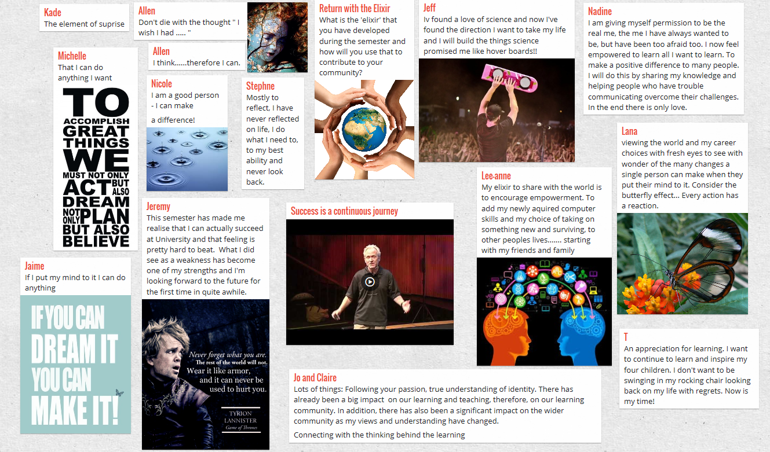
Padlet
Notes:
http://padlet.com/my/padlets

Slide 14
References
Bamber, J & Tett, L (2000) Transforming the learning experiences of non-traditional students : A perspective from higher education. Studies in Continuing Education.
Hunt, L & Chalmers, D (Eds)(2012) University Teaching in Focus. A learning-centred approach. Victoria: ACER.
Nelsen, K & Creagh, T (2012) A social justice framework for safeguarding student learning engagement. Retrieved June 12th, 2014, from www.safeguardingstudentlearning.net
Trifonas, P. P. (2002). Revolutionary pedagogies: Cultural politics, instituting education, and the discourse of theory. London: Taylor & Francis e-Library. Retrieved from http://books.google.com/books?hl=en&lr=&id=l8fx2-gSuoAC&oi=fnd&pg=PR9&dq=Revolutionary+Pedagogies:+Cultural+Politics,+Instituting+Education,+and+the+Discourse+of+Theory&ots=ITE27q7HsD&sig=czYKDfKAT0L_vQIO1oBl_DrJ2l0

Slide 15
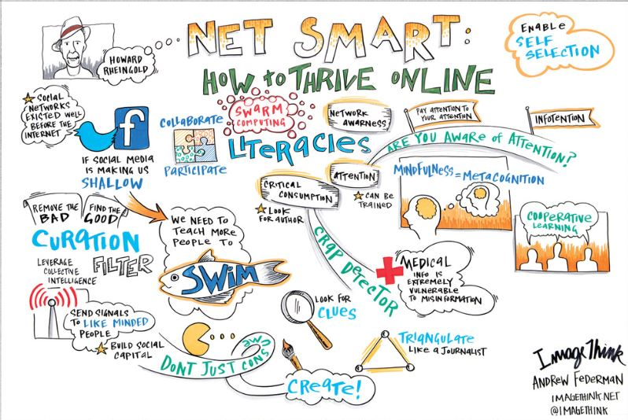
Notes:
Image:http://ogilvynotes.com/49790/456356/sxsw-2012/net-smart-how-to-thrive-online

Slide 16
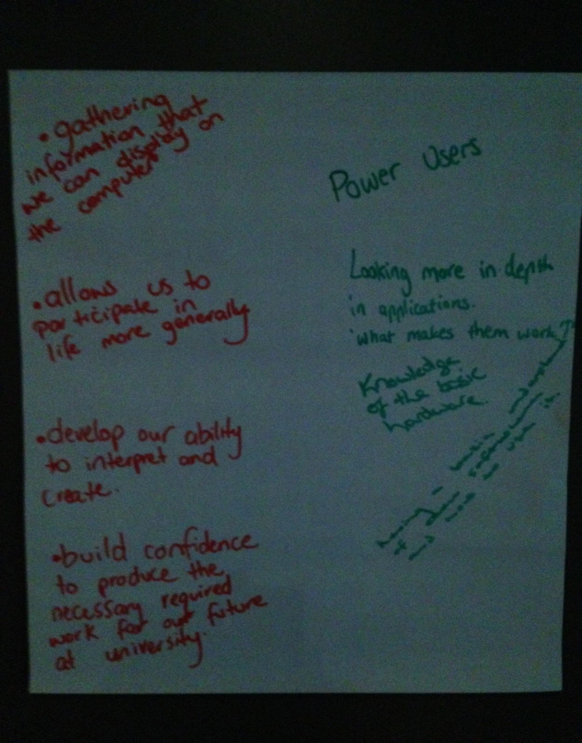

Slide 17
Kellner’s definition of computer literacy (2002)
‘Genuine computer literacy involves not just technical knowledge and skills, but refined reading, writing, research and communicating ability that involves heightened capacities for critically accessing, analysing, interpreting and processing print, image, sound and multimedia material. Computer literacy involves the ability to discover and access information and intensified abilities to read, to scan texts, computer databases and Web sites, and to download or print the information in a form appropriate for further information processing. Utilizing information accessed in an educational context further requires putting it together in meaningful patterns and mosaics to construct meanings and interpretations, to contextualize and evaluate, and to discuss and articulate one’s own views’

Slide 18
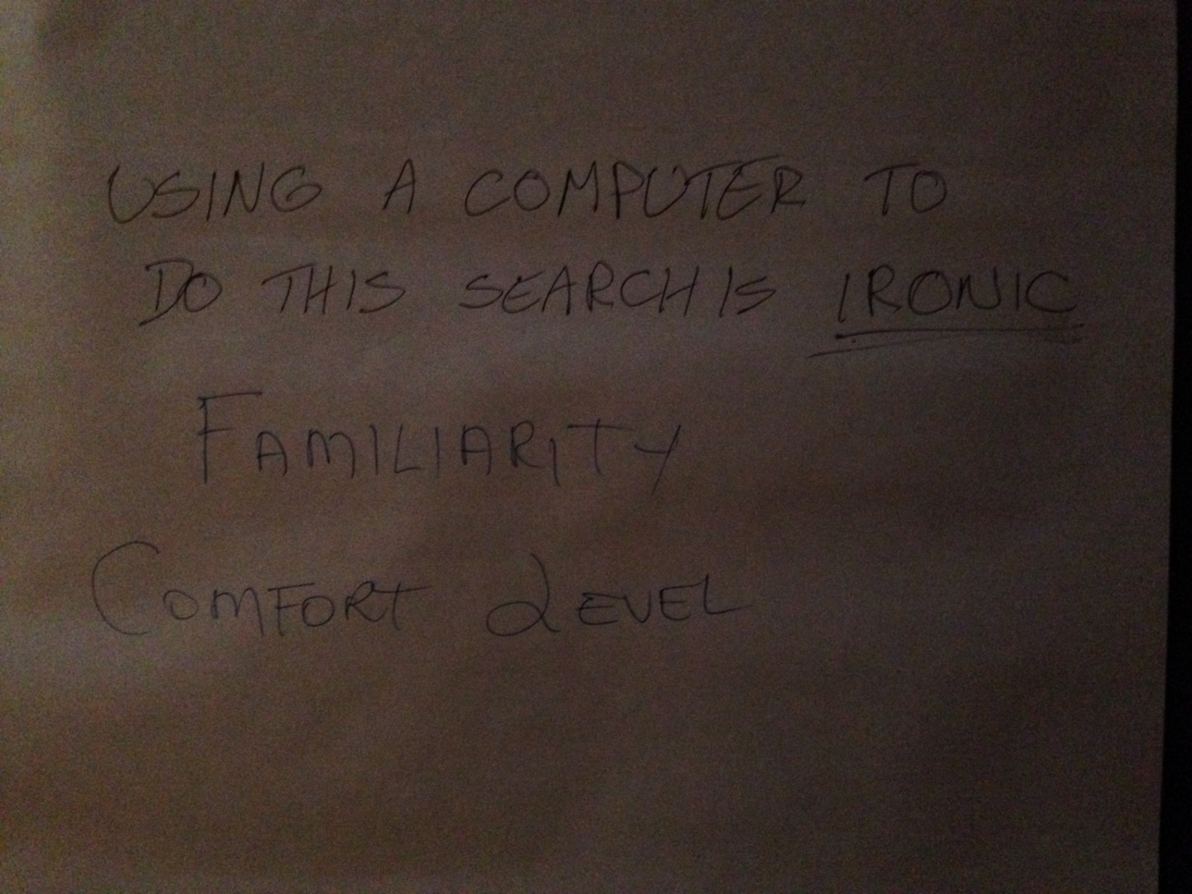
Notes:
Douglas Kellner’s Computer Literacy definition pp205-207 in Trifonas, 2002
Trifonas, P. P. (2002). Revolutionary pedagogies: Cultural politics, instituting education, and the discourse of theory. London: Taylor & Francis e-Library. Retrieved from http://books.google.com/books?hl=en&lr=&id=l8fx2-gSuoAC&oi=fnd&pg=PR9&dq=Revolutionary+Pedagogies:+Cultural+Politics,+Instituting+Education,+and+the+Discourse+of+Theory&ots=ITE27q7HsD&sig=czYKDfKAT0L_vQIO1oBl_DrJ2l0

